Slide 1


STUDENT DETAILS
Name:
Gampala Jai Anjaneya
College Name:
Aditya Engineering College
Roll No:
22A91A0476
Gmail:
gampalaanji124@gmail.com

Slide 2

PROJECT TITLE AND PROBLEM STATEMENT
1
Title:
Cyber Security in Projects: Hiding Text Inside Images Using Steganography
2
Problem Statement
In today's digital landscape, data breaches are a significant threat. Traditional encryption methods, while effective, can be circumvented. To address this, we propose a solution that utilizes steganography to embed text within images, making it nearly undetectable to unauthorized parties.

Slide 3

AGENDA
1
Introduction to Steganography
2
Project Overview
3
End Users
4
Solution & Value Proposition
5
Customization
6
Modelling
7
Results
8
References & Links

Slide 4
PROJECT OVERVIEW
Objective:
Methodology:
Tools and Technologies:
Our primary objective was to develop a robust steganography solution that enhances data security by embedding text within images. This solution should be effective in concealing sensitive information, making it nearly undetectable to unauthorized access.
We adopted a practical and iterative approach, employing a combination of image processing algorithms and data encoding techniques. Our chosen methodology ensured both efficiency and effectiveness in achieving our goals.
To achieve our objectives, we utilized a variety of tools and technologies, including Python programming language, OpenCV library for image processing, and specialized steganography libraries. These tools enabled us to implement our steganography algorithm.

Slide 5




WHO ARE THE END USERS OF THIS PROJECT?
Potential Users:
Our project is designed to benefit various stakeholders, including cybersecurity professionals who need to secure sensitive data, businesses looking to protect their confidential information, government agencies responsible for national security, and individuals who prioritize their digital privacy.
Use Cases:
Our steganography solution offers a wide range of practical applications. For instance, it can be used to securely communicate sensitive information, protect confidential files from unauthorized access, and prevent data breaches.

Slide 6

YOUR SOLUTION AND ITS VALUE PROPOSITION
1
Solution Description:
Our solution utilizes a steganography technique known as Least Significant Bit (LSB) insertion. This method modifies the least significant bits of an image's pixels without noticeably altering the image's visual appearance. Each modified bit represents a portion of the hidden text message.
2
Benefits:
Our solution offers several advantages, including enhanced data security through covert communication, increased privacy by concealing sensitive information, and the ability to communicate information without raising suspicion.
3
Differentiation:
Our solution differentiates itself through its simplicity and effectiveness. Unlike some complex steganography methods, our LSB insertion approach is easily implemented and yields high levels of data security.

Slide 7

HOW DID YOU CUSTOMIZE THE PROJECT AND MAKE IT YOUR OWN?
Customization:
We customized the standard LSB insertion technique by incorporating a unique key-based encryption algorithm. This additional layer of security ensures that only authorized individuals with the correct key can decode the hidden message.
We implemented a user-friendly interface that allows users to easily select images, input text, and encrypt or decrypt messages. This interface was designed with simplicity and intuitive navigation in mind.
Personal Touch:
During the project, we faced the challenge of balancing data security with the preservation of image quality. We addressed this by carefully selecting the least significant bits for modification, ensuring that the changes were imperceptible to the human eye.
Challenges and Solution:

Slide 8
MODELLING
Techniques Used:
Process:
Tools:
We employed a range of techniques during the modelling phase, including Least Significant Bit (LSB) insertion for data embedding, image processing algorithms for pixel manipulation, and Python libraries like OpenCV and Pillow for image manipulation and data encoding.
Our modelling process began with data collection and pre-processing. We then implemented the LSB insertion algorithm to embed text into images. The next step involved encrypting the hidden message with our unique key-based algorithm. We then tested our solution using various images and text messages, evaluating its effectiveness and security.
We primarily used the Python programming language for implementing our steganography solution. Key tools included the OpenCV library for image processing, the Pillow library for image manipulation, and specialized libraries for encryption and data encoding.

Slide 9
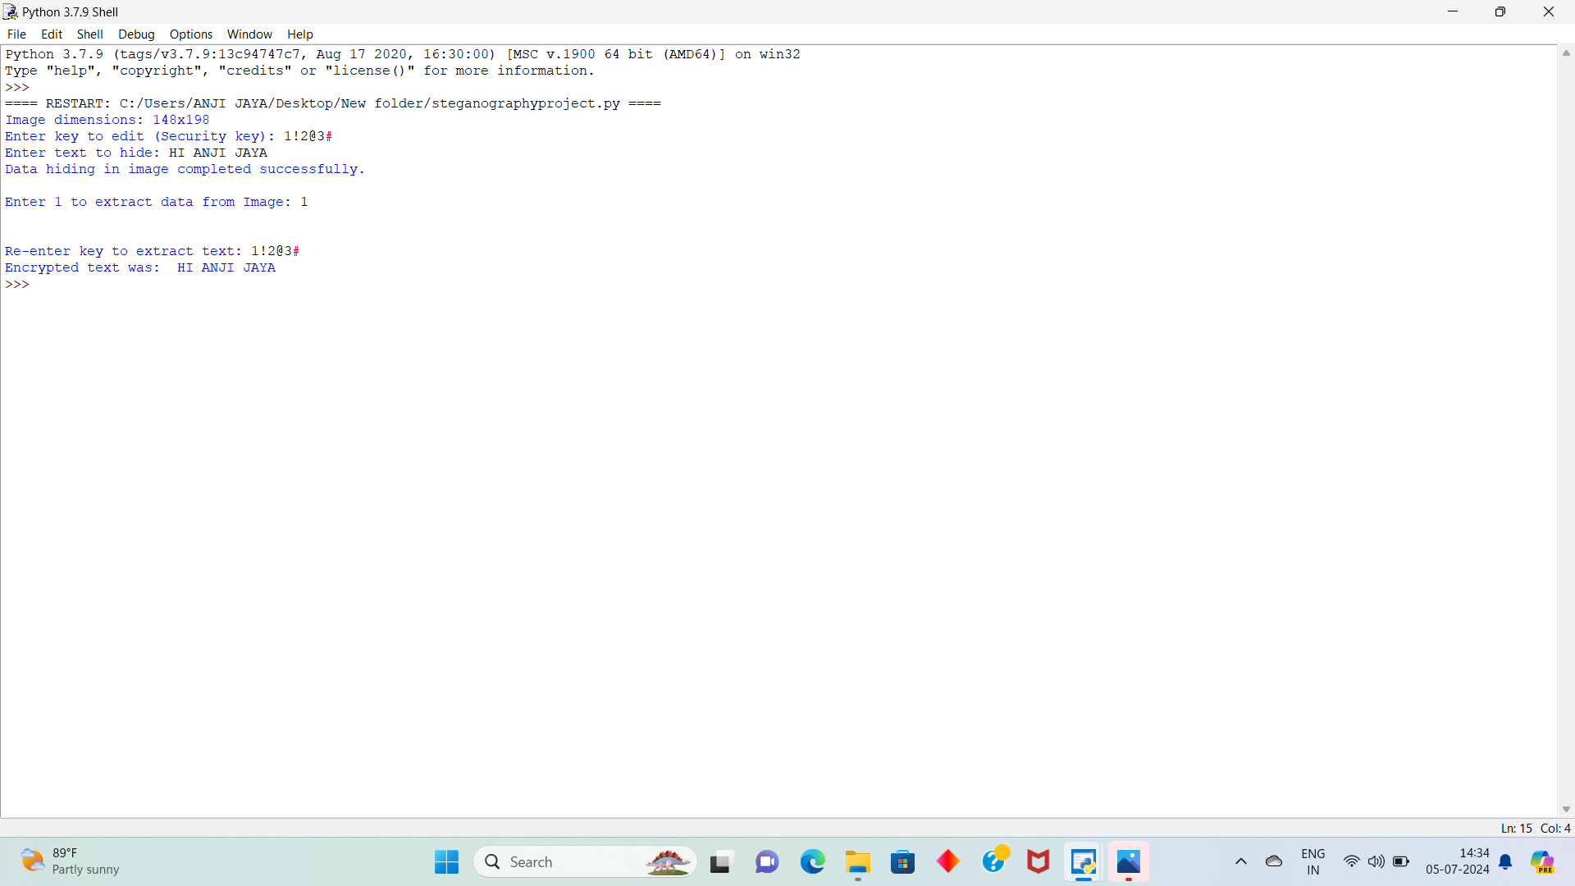
RESULTS

Slide 10
LINK
https://github.com/Anjigampala/Gampala-Jai-Anjaneya.git

